Slide 1
OOPS Concepts & Coding Practice
25-08-2023
Krunal Kshirsagar

Slide 2
Agenda
OOPS Concepts
Programs

Slide 3
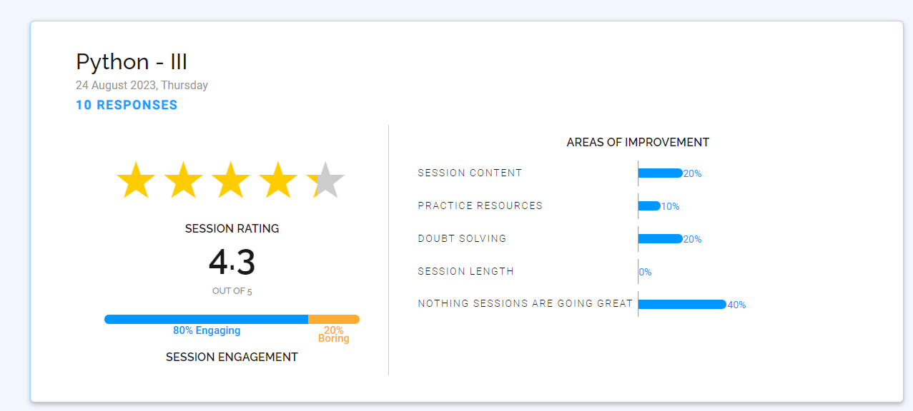

Slide 4

Object-Oriented Programming (OOPS)
OOPS provides a structured way to design and organize code
It promotes reusability, modularity, and code organization

Slide 5
Objects
Classes
Encapsulation
Abstraction
Inheritance
Polymorphism

Slide 6
Objects and Classes
An object is a self-contained unit that contains both data and behavior.
A class is a blueprint for creating objects of a particular type.
Objects are instances of a class.
What is a constructor and default constructor?

Slide 7
Encapsulation
Benefits:
Data hiding and protection
Modularity
Improved code organization
Encapsulation refers to bundling data (attributes) and methods (functions) that operate on that data into a single unit (object).
Access to the data is controlled through methods.

Slide 8
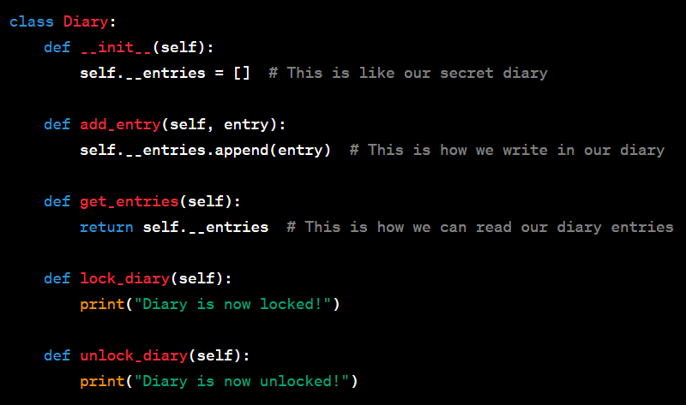
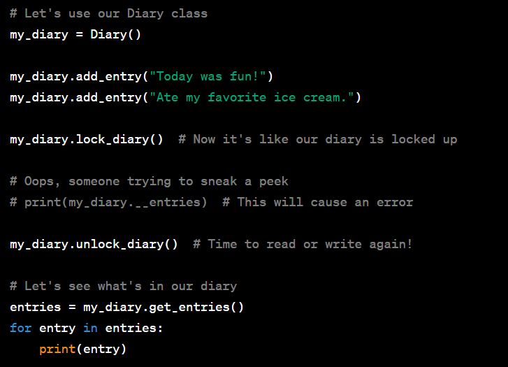

Slide 9
Abstraction
Benefits:
Hides complexity
Enhances code readability
Abstraction involves focusing on the essential properties and behaviors of an object, while ignoring the unnecessary details.
It simplifies complex reality by modeling classes based on their most relevant characteristics.

Slide 10
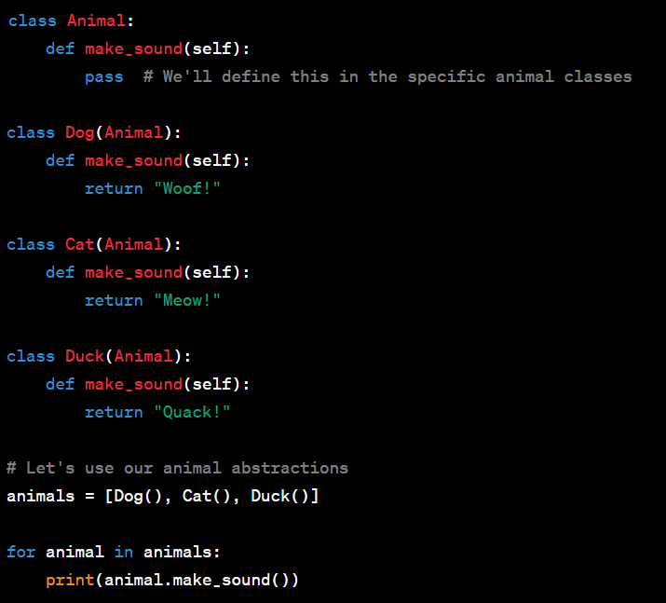

Slide 11
Inheritance
Inheritance allows a class (subclass or derived class) to inherit attributes and methods from another class (superclass or base class).
It promotes code reuse and the creation of specialized classes.
https://www.w3schools.com/python/python_inheritance.asp

Slide 12
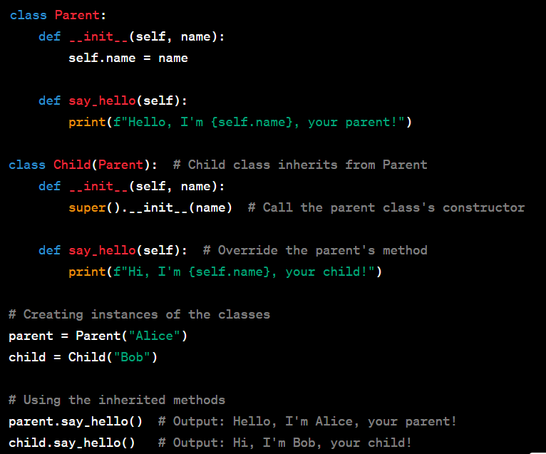

Slide 13
Polymorphism
Polymorphism allows objects of different classes to be treated as objects of a common base class.
It enables flexibility and extensibility in code.
https://www.w3schools.com/python/python_polymorphism.asp

Slide 14
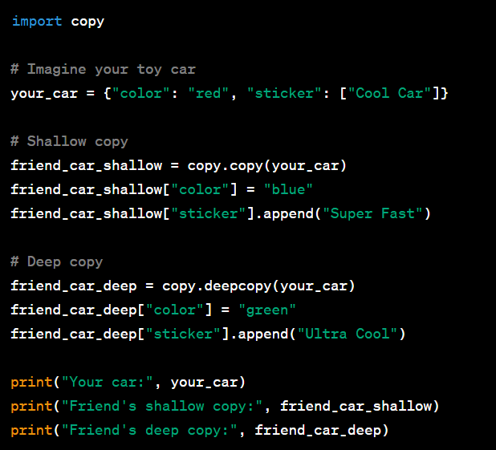

Slide 15
PROGRAMS

